Slide 1
4th Grade News
What’s Happening 10/29-11/9
Reminders/Other Notes
10/30: Picture Retakes
11/2: Pajama Day
11/4-11/8: Book Fair
11/8: Book Fair (4:00-6:30PM)
11/8: Open House (4:30-6:00PM)
Did you know that ALL 4th grade students and their guests can attend national parks for free?
Use the link below to find more information!
https://www.everykidinapark.gov/
A Peek At What We Are Learning
Reading | Nonfiction Reading: Text Features; Text Structure Reading Homework Due 11/1
Writing | Supporting Opinion Reasons with Strong Evidence Grammar: Subject Verb Agreement; Compound Subject & Predicate; Homophones; Grammar HW due 11/8; Writing Workshop Test 11/2
Math | 2 Digit by 2 Digit Multiplication; Division Multiplication Test- 11/2 Daily Math Quiz Weeks 11 & 12- 11/8
Science | Force & Motion Energy, Force & Motion Test 11/9
How to Help at Home
Review your child’s planner for homework assignments.
Encourage your child to spend time reading every night.
Practice all fast facts: addition, subtraction, multiplication, and division.
Visit our OKE 4th Grade website for helpful links & resources!

Slide 2
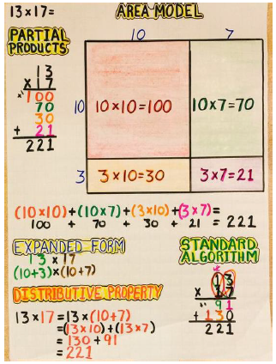
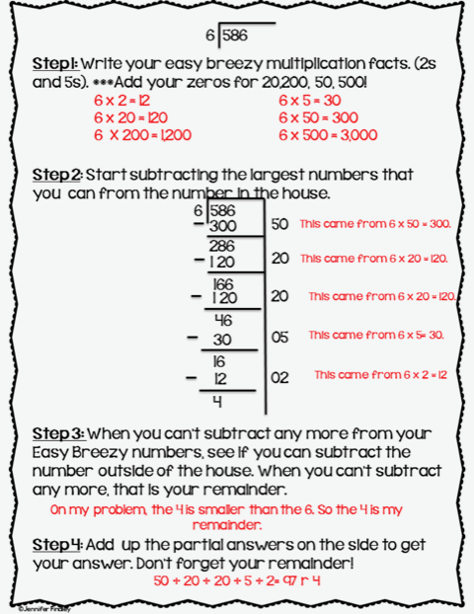
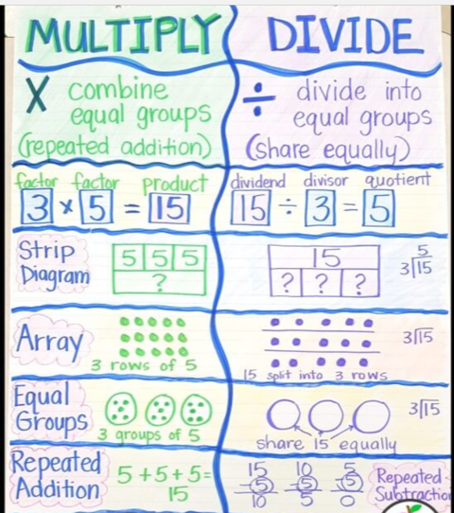
Helpful Ways to Review Math

Slide 3
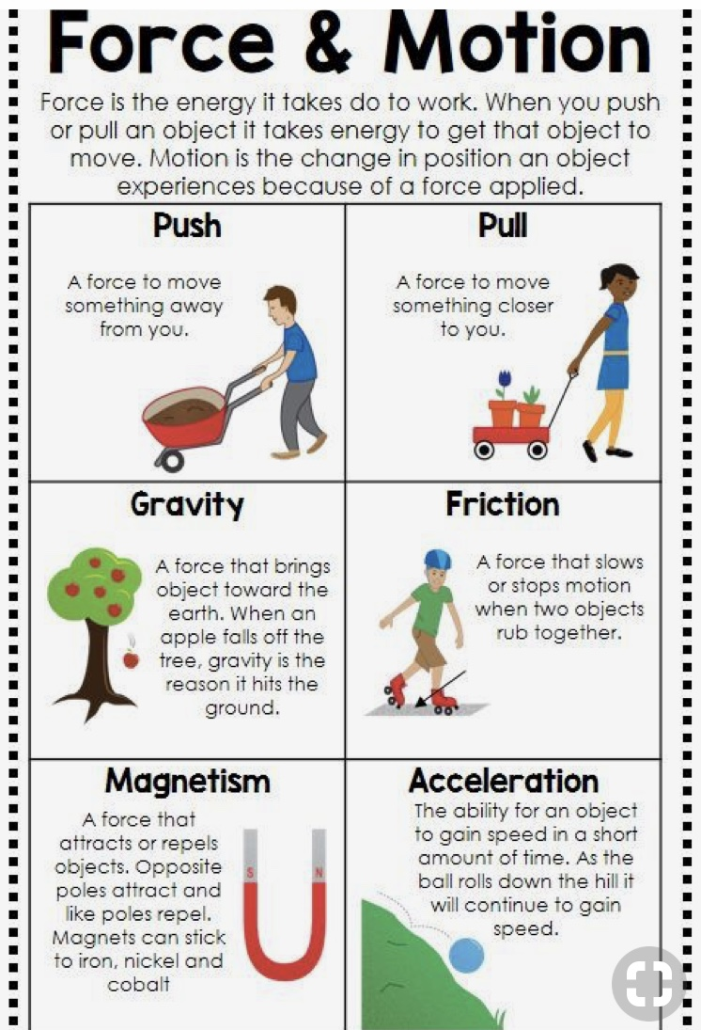
Helpful Ways to Review Science

Slide 4
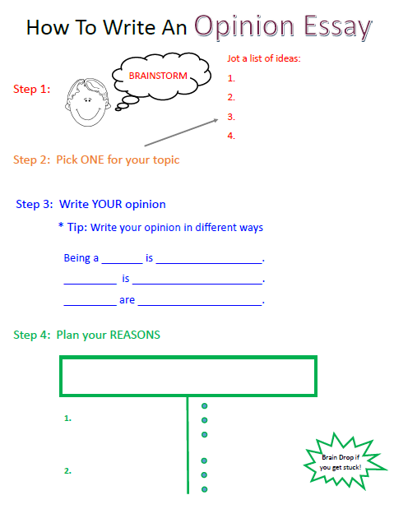
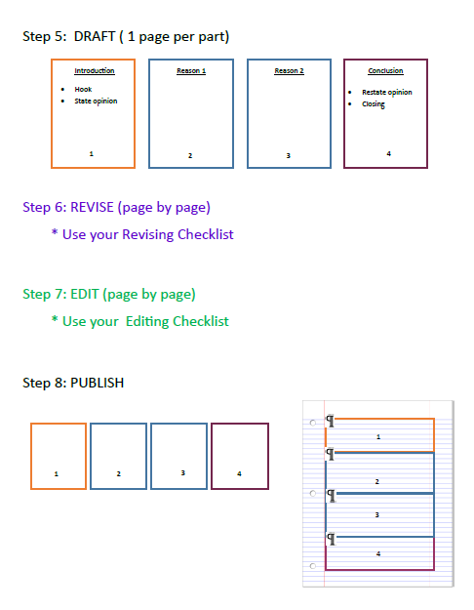
Helpful Ways to Review Writing
Launching Expository Writing with Opinion Essays
Grammar Anchor Charts

Slide 5
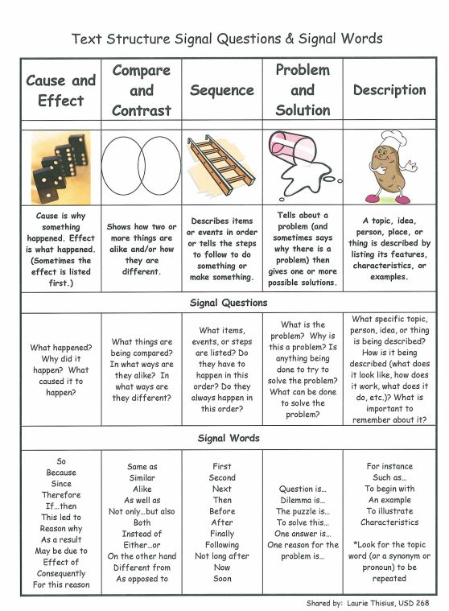
Helpful Ways to Review Reading
Text Structures

